Slide 1


Channel Feedback for Reconfigurable Intelligent Surface Assisted Wireless Communications
Decai Shen, Linglong Dai
Department of Electronic Engineering
Tsinghua University
December, 2020

Slide 2
Background
Proposed solution
Simulation results
Conclusions

Slide 3
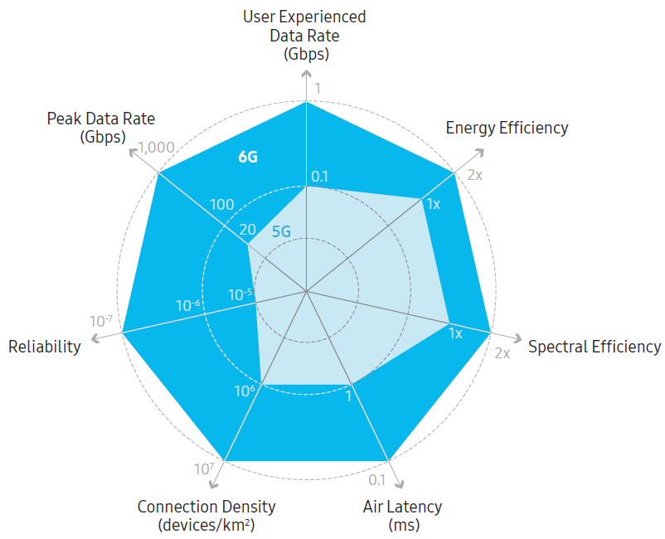

Background
Key performance requirements for 6G communication
  2x of increase in energy efficiency
  100x of increase in reliability
Samsung, “6G The next hyper——Connected experience for all,” Jul. 2020.

Slide 4

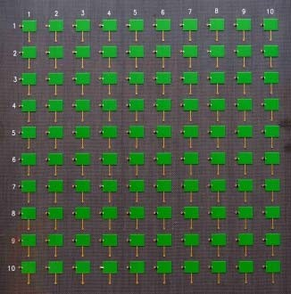
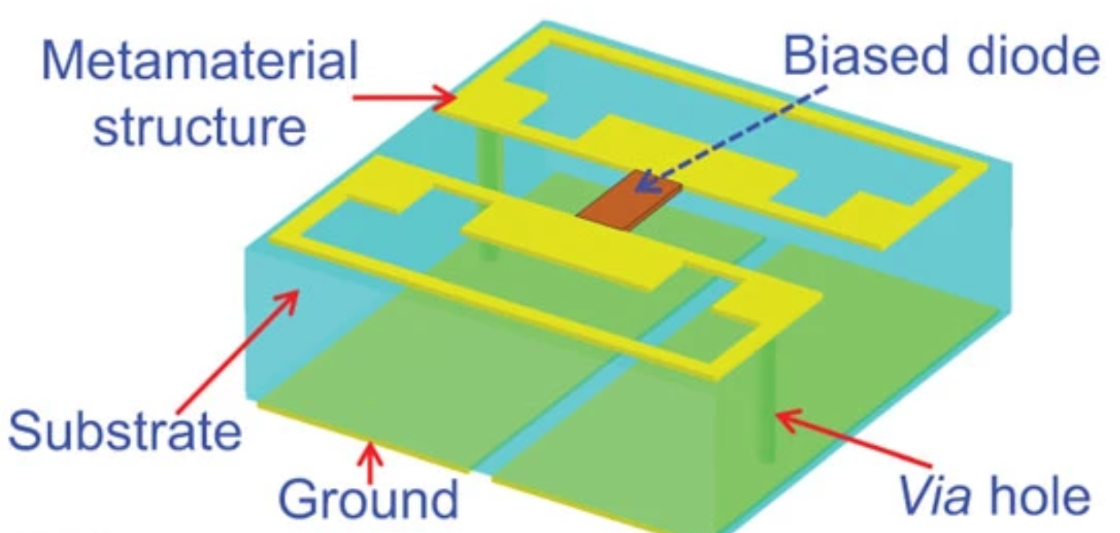
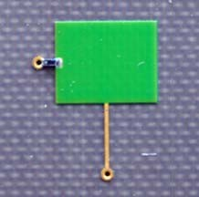
Background
Reconfigurable Intelligent Surface, RIS
  A surface of reconfigurable metamaterial
  Intelligently control the propagation of electromagnetic wave
  Manipulate the channel to improve the quality of the signal
PIN diode
[1] T. Cui, M. Qi, X. Wan, J. Zhao, and Q. Cheng, “Coding metamaterials, digital metamaterials and programmable metamaterials,” Light:
Science & Applications, vol. 3, p. e218, Oct. 2014.
[3] H. Yang, X. Cao, F. Yang, J. Gao, S. Xu, M. Li, X. Chen, Y. Zhao, Y. Zheng, and S. Li, “A programmable metasurface with dynamic
polarization, scattering and focusing control,” Scientific Reports, vol. 6, p. 35692 EP, Oct. 2016.

Slide 5
Background
RIS vs. Massive MIMO
 | Massive MIMO | RIS
System Architecture
Beamforming | Yes | Yes
RF Chain | Yes | No
Energy Consumption | High | Negligible
CSI Acquisition | Normal | Complicated
micro controller

Slide 6
TDD or FDD
Time Division Duplex (TDD)
  The same frequency band is occupied by the uplink and downlink transmission.
  Channel reciprocity can be exploited for downlink CSI acquisition.
  Pilot pollution results in the CSI acquisition errors.
Frequency Division Duplex (FDD)
  Different frequency bands are occupied by uplink and downlink transmission.
  Mitigate pilot pollution and support the ultra high-speed mobile scenario.
  Channel reciprocity does not hold, channel feedback is essential for CSI acquisition.
Channel Estimation
Channel
BS
Channel Feedback
User

Slide 7
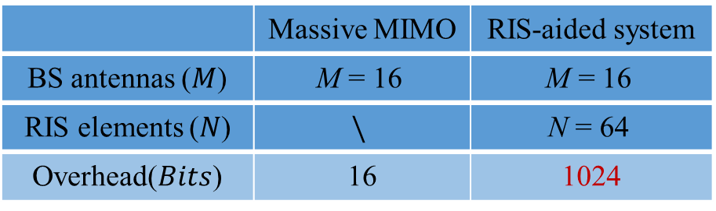
Main Challenges for Channel Feedback
Channel feedback for massive MIMO communications
  Downlink CSI is quantized as a codeword selected from a codebook, and the index of this codeword is fed back to the BS by user.
Main challenges for RIS-aided wireless communications
  Overhead: In proportion to the number of NM
  Performance: More sensitive to the feedback errors
increase times
(e.g., 64)
 | Massive MIMO | RIS-aided system
BS antennas ($M$) | $$\text{M}\text{ = }\text{16}$$ | $$\text{M}\text{ = }\text{16}$$
RIS elements ($N$) | $$\backslash$$ | $$\text{N}\text{ = }\text{64}$$
Overhead($Bits$) | 16 | 1024
Without RIS
With RIS
Unaffordable overhead for channel feedback!

Slide 8
Background
Proposed solution
Simulation results
Conclusions

Slide 9
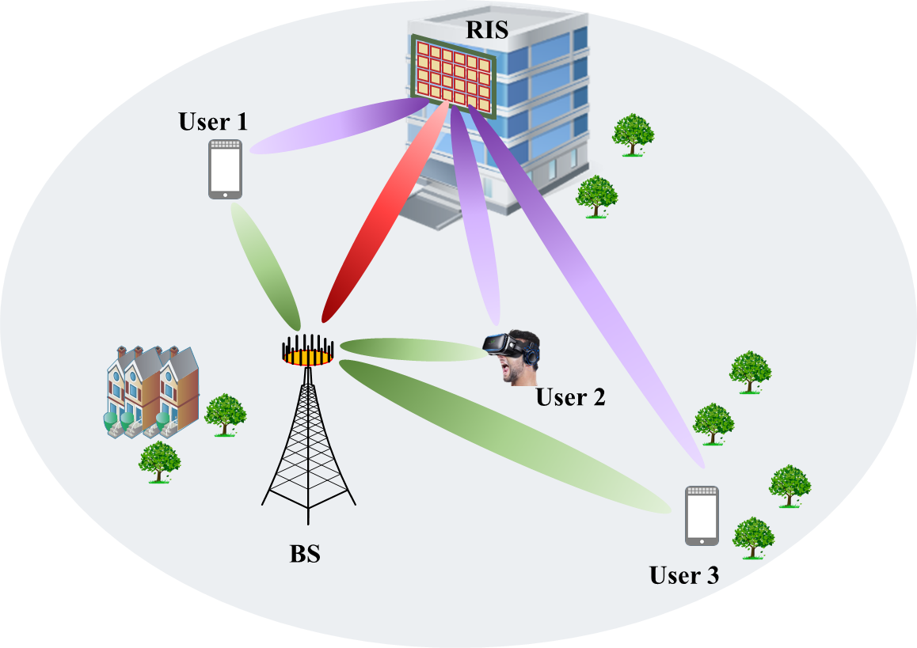
System Model
System model
  One base station (BS) with M antennas is aided by an RIS with N elements to simultaneously serve K single-antenna users (UEs) working on FDD mode.
Channel feedback
  We focus on the BS-RIS-UE cascaded channel feedback.

Slide 10
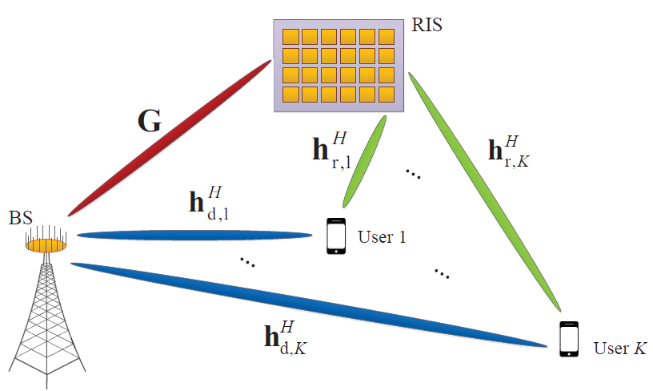
System Model
Downlink channel model
  The downlink channel for the k-th user
  represents the reflecting diagonal matrix, and the n-th element can be expressed as
Direct
Channel
Reflecting
Channel
Need to
be fed back
Cascaded Channel

Slide 11
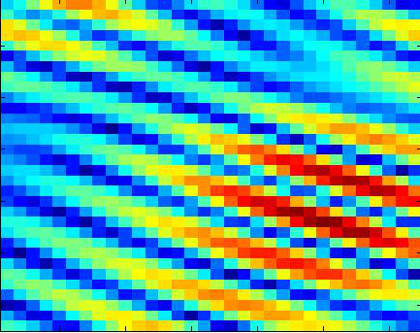
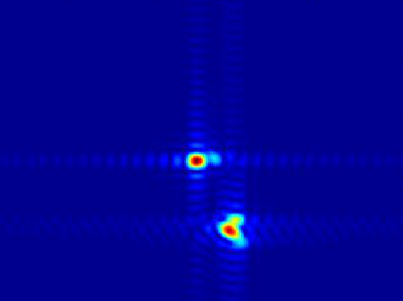



Single-Structured Sparsity of Cascaded Channel
The property for cascaded channel
  The BS and RIS are usually deployed in the high tower and the roof of the building, based on which there are a few scatterers between the BS and RIS.
  Taking the channel between the BS and the n-th element of the RIS as an example
  Spatial DFT
Non-sparse
spatial-domain
channel
Sparse
angular-domain
channel

Slide 12
Single-Structured Sparsity of Cascaded Channel
Cascaded channel model
  The BS-RIS and RIS-UE channel can be expressed based on Saleh-Valenzuela model as
Num. of BS-RIS paths
BS AoD
RIS AoA
Cascaded channel
Num. of RIS-UE paths
RIS AoD
  Steering vector

Slide 13
Single-Structured Sparsity of Cascaded Channel
Cascaded channel model
  The cascaded channel can be expressed as
  RIS cascaded AoA:
  The cascaded channel consists of the user-independent BS-RIS channel and user-specific RIS-UE channel.
  RIS Cascaded AoA
  BS
  AoD
Cascaded channel
  Cascaded channels for different users share the same spare BS-RIS channel

Slide 14

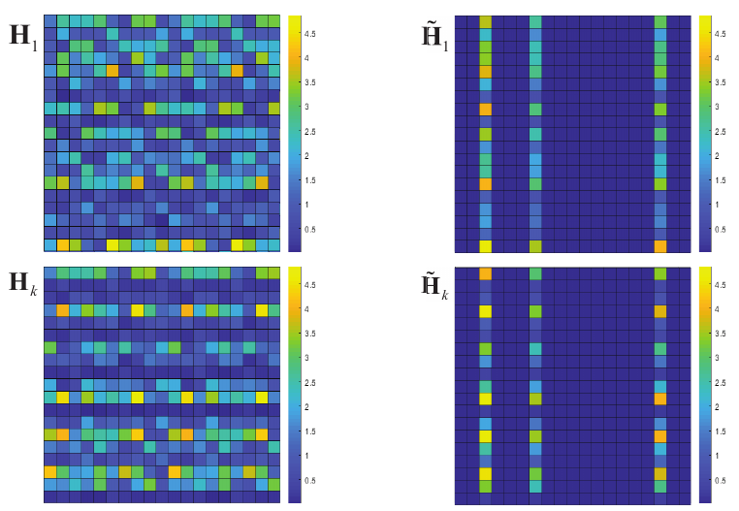
Single-Structured Sparsity of Cascaded Channel
Hybrid spatial- and angular-domain channel
  Hybrid-domain: since in the column dimension is converted into the angular domain, while channel in row dimension is still in the spatial domain.
Spatial-domain
channel
Hybrid-domain
channel
Dictionary matrix
Hybrid-domain channel is sparse in the column dimension;
Non-zero columns of different UEs have the same column indexes

Slide 15
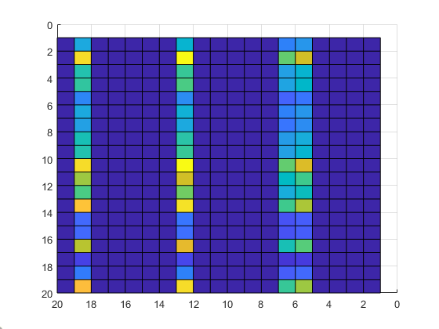
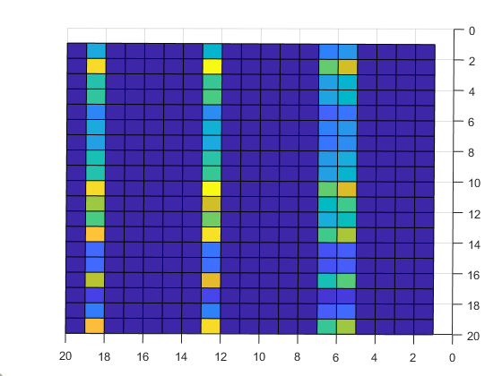


Dimension Reduced Channel Feedback Scheme
User-independent CSI and User-specific CSI
  We focus on the channel feedback in hybrid domain.
  The task of channel feedback is decomposed as the user-independent CSI feedback and user-specific CSI feedback.
  User-independent CSI: The indexes of the non-zero columns
  User-specific CSI: The non-zero column vectors of different users
  User-independent CSI
…
  User-specific CSI
  for 1st user
  User-specific CSI
  for k^{th} user

Slide 16
Dimension Reduced Channel Feedback Scheme
User-independent CSI and User-specific CSI
  The i-th non-zero column, which is also the -th column of
  Since , , based on which we have
  User-independent CSI
…
  User-specific CSI
  for 1st user
  User-specific CSI
  for k^{th} user

Slide 17
Dimension Reduced Channel Feedback Scheme
User-independent CSI feedback
  The user-independent CSI are also the grid indexes of the AoDs of the corresponding channel paths.
  Different users share the same set of non-zero column indexes.
  The number of users who feed back the user-independent CSI can be reduced from K to only 1.
  User-independent CSI
…

Slide 18
Dimension Reduced Channel Feedback Scheme
User-specific CSI feedback
  The i-th non-zero column, which is also the -th column of can be expressed as
  There N-dimensional channel vector is in the sub-space of a N-dimensional vector space , the sub-space is spanned by the columns of the steering matrix
  where , is the complex gain.
The N-dimensional vector space
The -dimensional
channel sub-space
  User-specific CSI
  for k^{th} user

Slide 19





Dimension Reduced Channel Feedback Scheme
User-specific CSI feedback: Generate the dynamic codebooks
  Different from the conventional scheme to use a constant codebook, we design dynamic codebooks for different non-zero column vectors.
  Generate the codebook for based on the channel angle information
  where the q-th codeword of the dynamic codebook
  and is a unit-norm vector chosen from the constant random vector quantization (RVQ) codebook consisting of 2^{B} codewords.
  The discrete angle is obtained by uniformly quantizing the continuous angle for digital transmission. The quantized steering matrix is

Slide 20
Dimension Reduced Channel Feedback Scheme
User-specific CSI feedback: Feedback for the codeword indexes
  For the non-zero column vector , the selected codeword with the index can be determined according to the objective function
  Then, the index will be fed back to the BS with B bits channel feedback overhead.
  Similarly, the codeword indexes for other non-zero columns can be fed back to the BS in the same procedure like the operation for the i-th non-zero column.

Slide 21
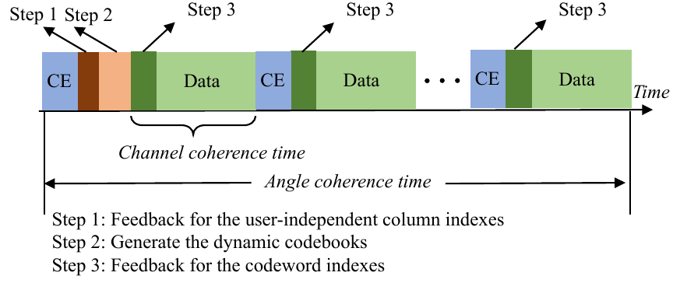
Dimension Reduced Channel Feedback Scheme
Frame structure for the proposed channel feedback
  The angles remain unchanged over a large period of time, which is called as angle coherence time.
  The step related to the angle information only need to be carried out once within the angle coherence time.

Slide 22
Background
Proposed solution
Simulation results
Conclusions

Slide 23
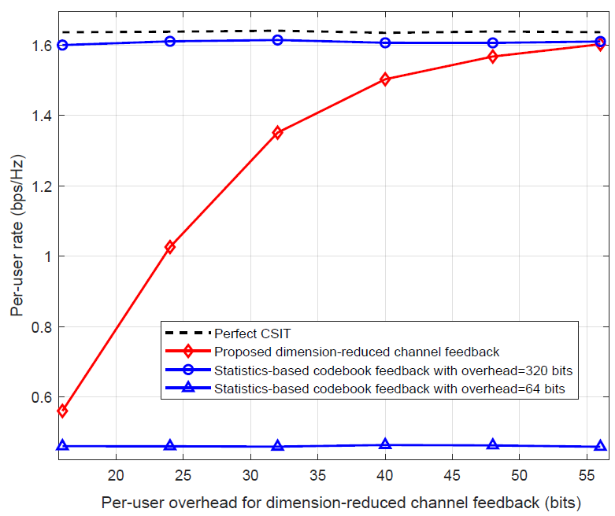
Simulation Results
Per-user rate performance versus the per-user overhead
Conventional scheme with
per-user overhead 320bits
Perfect CSI
Proposed scheme with
per-user overhead 56bits
    BS antennas M=32
    RIS elements N=64
    Users K=4
    SNR: 5 dB
    AoD resolutions =512
    Codebook size: 2¹~2¹¹
  The per-user overhead can be reduced by more than 80%
W. Shen, L. Dai, Y. Zhang, J. Li, and Z. Wang, “On the performance of channe-statistics-based codebook for massive MIMO channel feedback,” IEEE Trans. Veh. Technol., vol. 66, no. 8, pp. 7553-7557, Aug. 2017.

Slide 24
Background
Proposed solution
Simulation results
Conclusions

Slide 25
Conclusions
Single-structured sparsity
  The cascaded channel consists of the user-independent BS-RIS channel and user-specific RIS-UE channel.
  Hybrid-domain channel is sparse in the column dimension; Non-zero columns of different UEs have the same column indexes.
Dimension reduced channel feedback scheme
  The task of channel feedback is decomposed as the user-independent CSI feedback and user-specific CSI feedback.
  The number of UEs who feed back the user-independent CSI can be reduced from K to only 1. The number of column vectors which needs to be fed back can be reduced from M to channel paths L of BS-RIS channel.
  The per-user overhead for the proposed channel feedback scheme can be reduced by more than 80% compared with the conventional scheme.

Slide 26
Reference
Z. Zhang, Y. Xiao, Z. Ma, M. Xiao, Z. Ding, X. Lei, G. K. Karagiannidis, and P. Fan, “6G wireless networks: Vision, requirements, architecture, and key technologies,” IEEE Veh. Technol. Mag., vol. 14, no. 3, pp. 28–41, Sep. 2019.
C. Pradhan, A. Li, L. Song, B. Vucetic, and Y. Li, “Hybrid precoding design for reconfigurable intelligent surface aided mmWave communication systems,” IEEE Wireless Commun. Lett., vol. 9, no. 7, pp. 1041– 1045, 2020.
L. Dai, B. Wang, M. Wang, X. Yang, J. Tan, S. Bi, S. Xu, F. Yang, Z. Chen, M. D. Renzo, C. Chae, and L. Hanzo, “Reconfigurable intelligent surface-based wireless communications: Antenna design, prototyping, and experimental results,” IEEE Access, vol. 8, pp. 45 913– 45 923, 2020.
S. Chen, S. Sun, G. Xu, X. Su, and Y. Cai, “Beam-space multiplexing: Practice, theory, and trends, from 4G TD-LTE, 5G, to 6G and beyond,” IEEE Wireless Commun., vol. 27, no. 2, pp. 162–172, 2020.
W. Shen, L. Dai, B. Shim, Z. Wang, and R. W. Heath, Jr., “Channel feedback based on AoD-adaptive subspace codebook in FDD massive MIMO systems,” IEEE Trans. Commun., vol. 66, no. 11, pp. 5235–5248, Nov. 2018.
X. Gao, L. Dai, Y. Sun, S. Han, and C.-L. I, “Machine learning inspired energy-efficient hybrid precoding for mmWave massive MIMO systems,” in Proc. IEEE Int. Conf. Commun. (IEEE ICC’17), Paris, France, May 2017, pp. 1–6.

Slide 27
Thank you
Channel Feedback for Reconfigurable Intelligent Surface Assisted Wireless Communications
Decai Shen, Linglong Dai
December, 2020
E-mail: sdc18@mails.tsinghua.edu.cn
Website: http://oa.ee.tsinghua.edu.cn/dailinglong/
Notes:
Thank you!

